Slide 1
Java Programming
Classes and Objects
Unit I – Chapter 6

Slide 2
Class Fundamentals
Class Forms the basis for object-oriented programming in Java
Class defines a new “data-type” – using which objects are created.
Class contains: Data &/or Operations (on data)
A class is a template for an object, and an object is an instance of a class

Slide 3
General Form of a Class
class <class-name>
{
datatype1 var1;
datatype2 var2;
return-type method-name1(arguments)
{ }
return-type method-name2(arguments)
{ }
}

Slide 4
Class Fundamentals…
The data, or variables, defined within a class are called instance variables
Methods and variables defined within a class are called members of the class.
All methods are like main()
  But not all are declared as “static” and “public”

Slide 5




Declaring Objects
two-step process
  Declare a variable of the class type
  Sample s;
  Acquire an actual, physical copy of the object and assign it to that variable
  s= new Sample();
  Equivalent to, Sample s=new Sample();

Slide 6
Methods
Methods define the interface to most classes.
class sam {
void fun1()
{ }
int fun2()
{
……
return <int_var>
}
Object_name.<method_name>(arguments);

Slide 7
class sub
{
int a;
int b;
void get(int x,int y)
{
a=x;
b=y;
}
void put()
{
System.out.println("a="+a);
System.out.println("b="+b);
}
}
class sample
{
public static void main(String arg[])
{
sub s1=new sub();
sub s2=new sub();
s1.get(10,20);
s2.get(100,200);
s1.put();
s2.put();
}
}

Slide 8
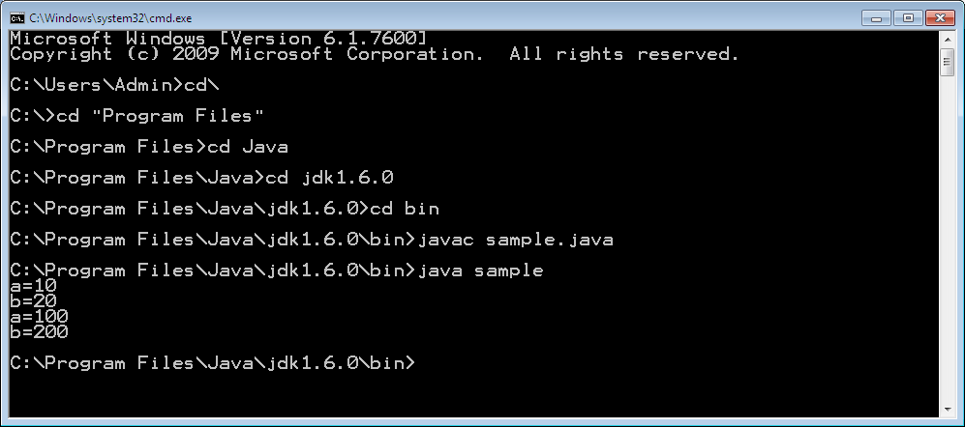

Slide 9










Assigning Object Reference Variables
Sample s1=new Sample()
Sample s2;
s2=s1;

Slide 10





Assigning Object Reference Variables
s1=null;

Slide 11
Main() takes arguments?
class sample
{
public static void main( String arg[]) throws Exception
{
System.out.print("The First Argument is:");
System.out.println(arg[0]);
System.out.print("The Second Argument is:");
System.out.println(arg[1]);
}
}

Slide 12
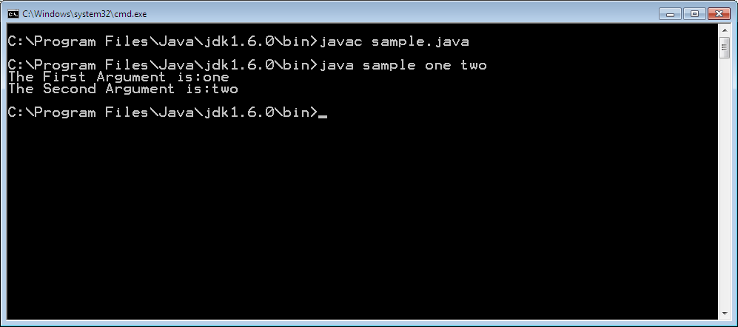

Slide 13
Constructor
A function that has the name of the class
A constructor initializes an object immediately upon creation
Automatically called when the object is created, before the new operator completes
No return type; even no “void”
  Reason: The implicit return type of a class’ constructor is the class type itself

Slide 14
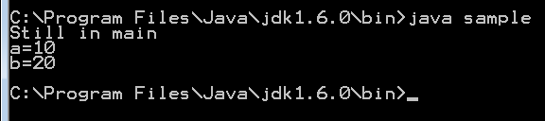
class sam
{
int a=10;
int b=20;
void put()
{
System.out.println("a="+a);
System.out.println("b="+b);
}
}
class sample
{
public static void main(String arg[])
{
sam s=new sam();
System.out.println("Still in main");
s.put();
}
}

Slide 15
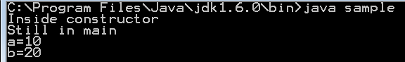
class sam
{
int a,b;
sam()
{ System.out.println(“Inside Constructor");
a=10; b=20;
}
void put()
{
System.out.println("a="+a); System.out.println("b="+b);
} }
class sample
{
public static void main(String arg[])
{
sam s=new sam(); // constructor is called here…
System.out.println("Still in main");
s.put();
} }

Slide 16
Parameterized Constructors
sam(int x, int y)
{
System.out.println(“Inside Constructor");
a=x; b=y;
}
sam s=new sam(10,20);

Slide 17
“this” Keyword
Used inside any method to refer to the current object
“this” is always a reference to the object on which the method was invoked.
class sam {
int a,b;
sam()
{ this.a=10; this.b=20;
} }

Slide 18
class sam {
int a,b;
sam(int x, int y)
{ this.a=x; this.b=y;
} }
Instance Variable Hiding: local variable hides the instance variable
class sam {
int a,b;
sam(int a, int b)
{ this.a=a; this.b=b;
} }

Slide 19
Garbage Collection
Java handles de-allocation automatically
Using garbage collection technique
  Idea: when no references to an object exist, that object is assumed to be no longer needed, and the memory occupied by the object can be reclaimed
Occurs sporadically (irregular intervals)

Slide 20
“finalize()” Method
Finalization mechanism: Used to destroy all allotted resources (other than memory) before destroying an object
This method defines specific actions that will occur when an object is called by garbage collector
    protected void finalize()
    {
    // finalize code here…
    }

Slide 21
Thank You

